Slide 1
DBSCAN Clustering
What is DBSCAN clustering:
DBSCAN is a density-based clustering algorithm that groups data points that are closely packed together and marks outliers as noise based on their density in the feature space. It identifies clusters as dense regions in the data space separated by areas of lower density. Unlike K-Means or hierarchical clustering which assumes clusters are compact and spherical, DBSCAN perform well in handling real-world data irregularities such as:
Arbitrary-Shaped Clusters: Clusters can take any shape not just circular or convex.
Noise and Outliers: It effectively identifies and handles noise points without assigning them to any cluster.
Analogy: Imagine you’re at a park:
Groups of friends are sitting close together on the grass.
A few people are wandering alone far from others.
DBSCAN says: “Clusters are groups with enough people sitting close together. Lone wanderers are noise.”

Slide 2
When to Use
When clusters are irregularly shaped (not spherical).
When you want to detect outliers.
When the number of clusters is unknown.
Useful in geospatial data, anomaly detection, image analysis.
Step‑by‑Step Process
Pick a point not yet visited.
Check neighbors within eps.
If neighbors ≥ min_samples → form a cluster.
Expand cluster by checking neighbors of neighbors.
If neighbors < min_samples → mark as noise.
Repeat until all points are visited.

Slide 3
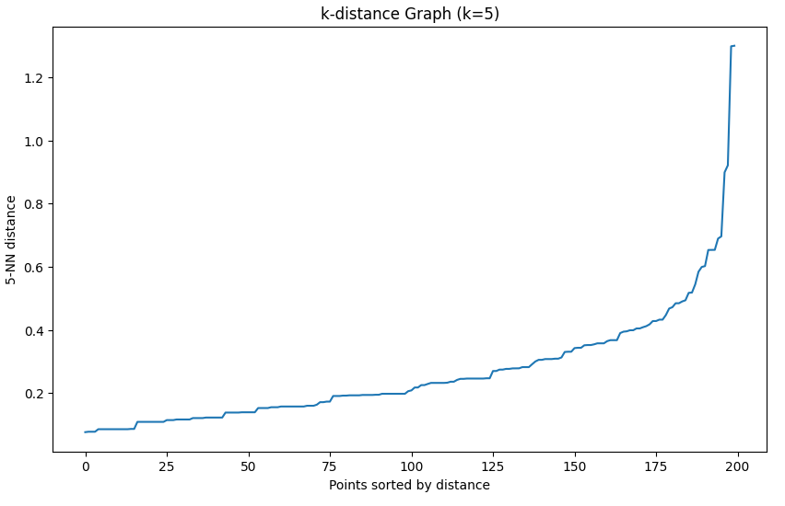
K-Distance to decide EPS Score

Slide 4
